Slide 1
AUTOMATED SOFT DRINK DISPENSER (USING ARDUINO)
DONE BY
SUBHRAJIT KARMAKAR
DIPAYAN PAL
ROUNAK SAHA

Slide 2

Certificate of Originality
Certificate of Approval
Acknowledgement.
Problem Statement .
Introduction
Objective
Role of Arduino
Member Roles
Hardware Requirements
Software Requirements
Miscellaneous Requirements
Hardware Tools
Modelling Tools…
Architecture
Arduino Nano
I2C OLED Display
Relay
Air Pump
Circuit Diagram
Hardware Implementation
Coding
Testing
Model Making
Discussions
Future Scopes
Credits
Gantt Chart
TOPIC

Slide 3
PROBLEM STATEMENT
Automated Soft drink Dispenser allows the user to select one out of the three options (small / medium / large) for the amount of liquid as desired.
INTRODUCTION
Soft Drink dispensers are the devices that are designed to serve soft drinks. Dispensers store soft drink and oxygen is prevented from entering the bottle when pouring so it preserve drink for long time.
It also reduces the error of spilling soft drink while pouring. The dispensers can be operated only by a nozzle, some by taps, and others by automatic dispensation in response to the button of size.
OBJECTIVE
1. The device will wait for the user to press KEY to activate.
2. KEY “SMALL” will pour 30ml of Soft drink.
3. KEY “MEDIUM” will pour 60ml of Soft drink.
4. KEY “LARGE” will pour 90ml of Soft drink.
5. The device will display according to the KEY pressed
6. The display will be very informative to display when not in use.
ABOUT

Slide 4
HARDWARE REQUIREMENTS
1. ARDUINO NANO
2. USB ADAPTER FOR ARDUINO NANO
3. MALE TO FEMALE JUMPER WIRE – 10
4. MALE TO MALE JUMPER WIRE – 10
5. TECTILE BUTTON SWITCH – 3
6. AIR PUMP-1
7. I2C OLED DISPLAY 0.96 INCH 128x64
8. PIPES
9. BOTTLE
10. RESISTORS
SOFTWARE REQUIREMENTS
1. ARDUINO IDE FOR CODING
2. CIRCUIT DIAGRAM FOR CIRCUIT DRAWING
REQUIREMENTS

Slide 5
MISCELLANEOUS REQUIREMENTS
A. HARDWARE TOOLS:
1. SOLDERING IRON
2. SOLDER
3. WIRES
4. WIRECUTTERS
BREADBOARD
B. MODELLING TOOLS:
1. CARDBOARD
2. SCISSORS
3. GUM
4. CELLOTAPE
5. RULER
6. PENCILS AND ERASERS
7. CUTTERS
REQUIREMENTS

Slide 6
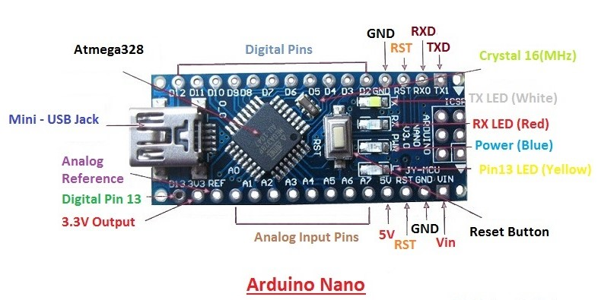
ARDUINO NANO
ARCHITECTURE
Arduino Nano is a microcontroller based on Atmel ATmega328 which is a low power CMOS 8-bit microcontroller based on the AVR enhanced RISC architecture.
By executing a powerful single clock cycle, the ATmega328 achieves throughputs approaching 1 MIPS per MHz allowing the system designer to optimize power consumption versus processing speed.

Slide 7
Power:
The Arduino Nano can be powered via the Mini-B USB connection, 6-20V unregulated external power supply (pin 30), or 5V regulated external power supply (pin 27). The power source is automatically selected to the highest voltage source
Memory:
The ATmega328 has 32 KB, (also with 2 KB used for the bootloader. The ATmega328 has 2 KB of SRAM and 1 KB of EEPROM.
Communication:
The Arduino Nano has a number of facilities for communicating with a computer, another Arduino, or other microcontrollers. The ATmega328 provide UART TTL (5V) serial communication, which is available on digital pins 0 (RX) and 1 (TX). An FTDI FT232RL on the board channels this serial communication over USB and the FTDI drivers (included with the Arduino software) provide a virtual com port to software on the computer. The Arduino software includes a serial monitor which allows simple textual data to be sent to and from the Arduino board. The RX and TX LEDs on the board will flash when data is being transmitted via the FTDI chip and USB connection to the computer (but not for serial communication on pins 0 and 1). A. The Arduino software includes a Wire library to simplify use of the I2C bus.
Programming:
The Arduino Nano can be programmed with the Arduino software (download). Select Nano w/ ATmega328" from the Tools > Board menu (according to the microcontroller on your board). The ATmega328 on the Arduino Nano comes pre burned with a bootloader that allows you to upload new code to it without the use of an external hardware programmer.
2
ARCHITECTURE

Slide 8
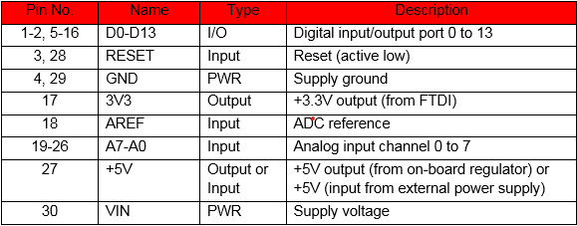
PIN DESCRIPTION
ARCHITECTURE

Slide 9
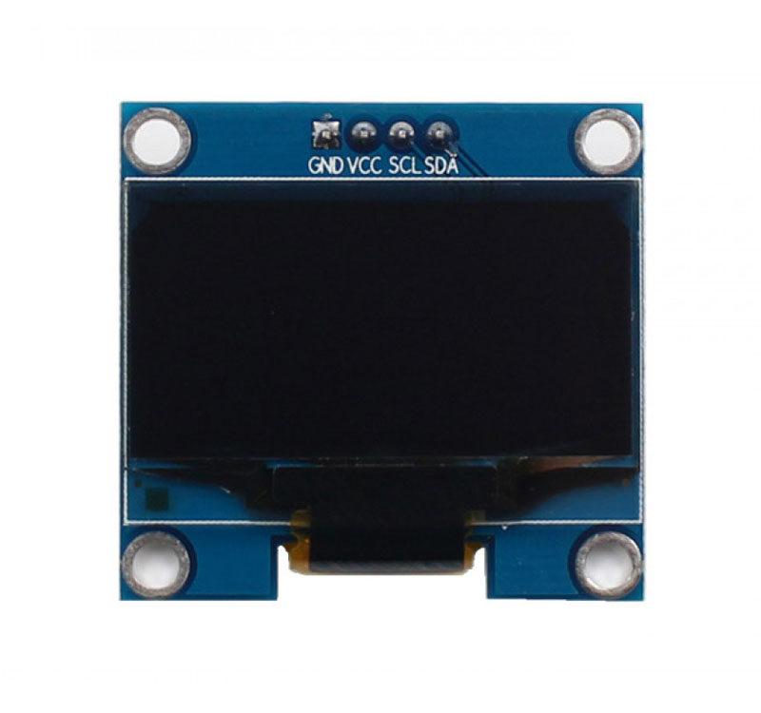
I2C OLED DISPLAY
ARCHITECTURE
0.96 inch OLD display module can be interfaced with any microcontroller using IIC protocols. The package include display board, display, 4 pin male header presoldered to board. OLED(Organic Light-Emitting Diode) is a self light -emitting technology composed of a thin, multi-layered organic film placed between an anode and cathode. In contrast to LCD technology, OLED does not require a backlight.
OLEDs basic structure consists of organic materials positioned between the cathode and the anode, which is composed of electric conductive transparent Indium Tin Oxide (ITO). The organic materials compose a multi-layered thin film, which includes the Hole Transporting Layer (HTL), Emission Layer (EML) and the Electron Transporting Layer (ETL). By applying appropriate voltage, holes and electrons are injected into the EML from the anode and the cathode respectively. The holes and electrons combine inside the EML to form excitons, after which electro luminescence occurs. The transfer material, emission layer material and choice of electrode are the key factors that determine the quality of OLED components.

Slide 10
FEATURES OF 0.96 INCH OLED DISPLAY MODULE
Viewing angle : greater than 160 degrees
Resolution: 128 x 64
Low power consumption : 0.04W during normal operation
Support wide voltage : 3.3V-5V DC
Driver IC : SSD1306
Communication : IIC, only two I / O ports
Backlight : OLED self light, no backlight
Interface: VCC: 3.3-5V
GND: Ground
SCL: Serial Clock
SDA: Serial Data
ARCHITECTURE

Slide 11
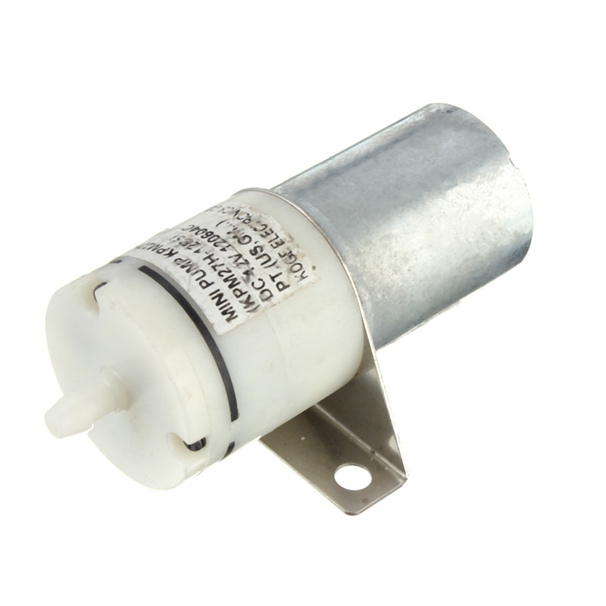
AIR PUMP
ARCHITECTURE
Air pump is a device that is used for pumping the air using power supply provided to it. The two of its terminals are used in supplying power and it has one end which is connected to pipe that creates air suction, thus making vacuum. It has various kind of use.
Working voltage 5V DC and current ~0.25A.

Slide 12
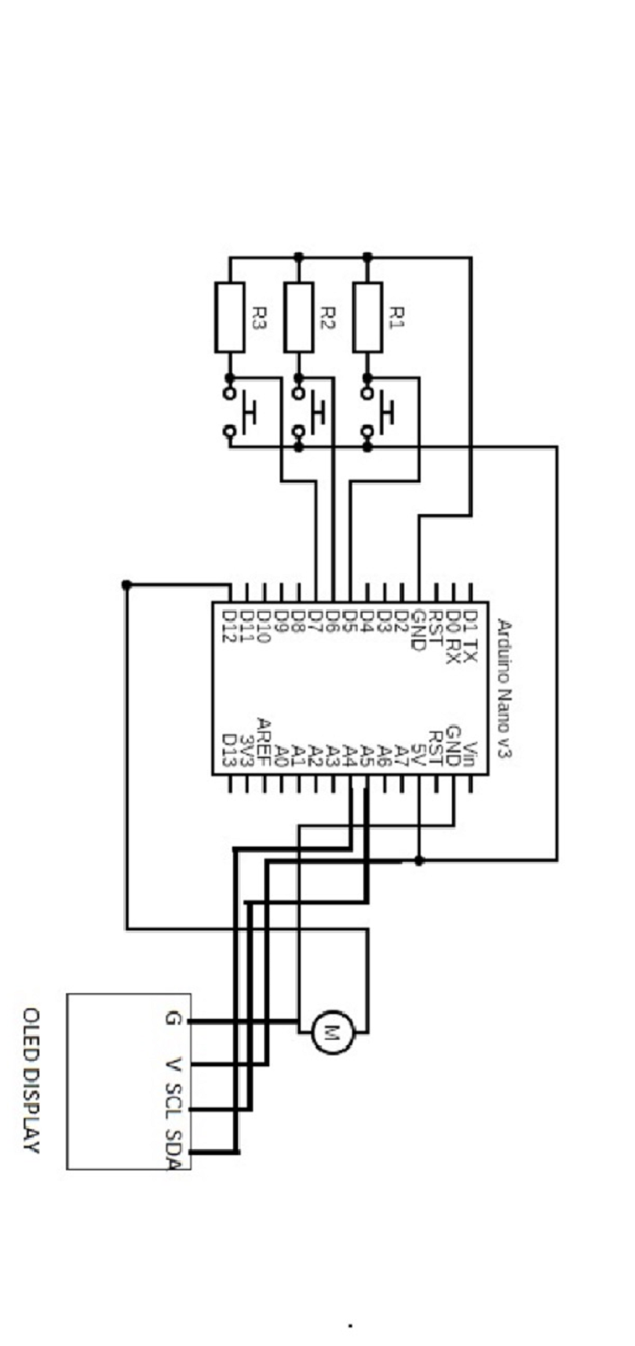
CIRCUIT DIAGRAM

Slide 13
HARDWARE IMPLEMENTATION
Implementation of soft drink dispenser based on Arduino nano, motor and switches. Here we control the Arduino using switches. There are three switches one for small amount of soft drink, another two for medium and large amount of drinks respectively. Switches are connected with ground, vcc and digital input/output pins of Arduino. The air pump is connected to output pin of nano and to ground connection. Air pump’s nozzle is connected to bottle with a pipe and another pipe is also put inside the bottle to get drinks from it. We use a oled display to show the amount of drink is dispensed. Oled display is connected to ground, vcc and dedicated analog input/output pins of Arduino. When a switch is pressed the dedicated pin of Arduino gets HIGH voltage and due to appropriate coding it turn the output pin of Arduino nano HIGH 5V. Air pump get power and then it starts pulling water from bottle and water starts pouring from another end of the pipe. In the meanwhile, oled display is also turned on and display the amount of selected drink. After few moments the pouring of drink is accomplished and all the digital input/output pins are at LOW voltage. When we press a switch again the process will start. We use male to male and male to female wires for better reliability.
IMPLEMENTATION

Slide 14
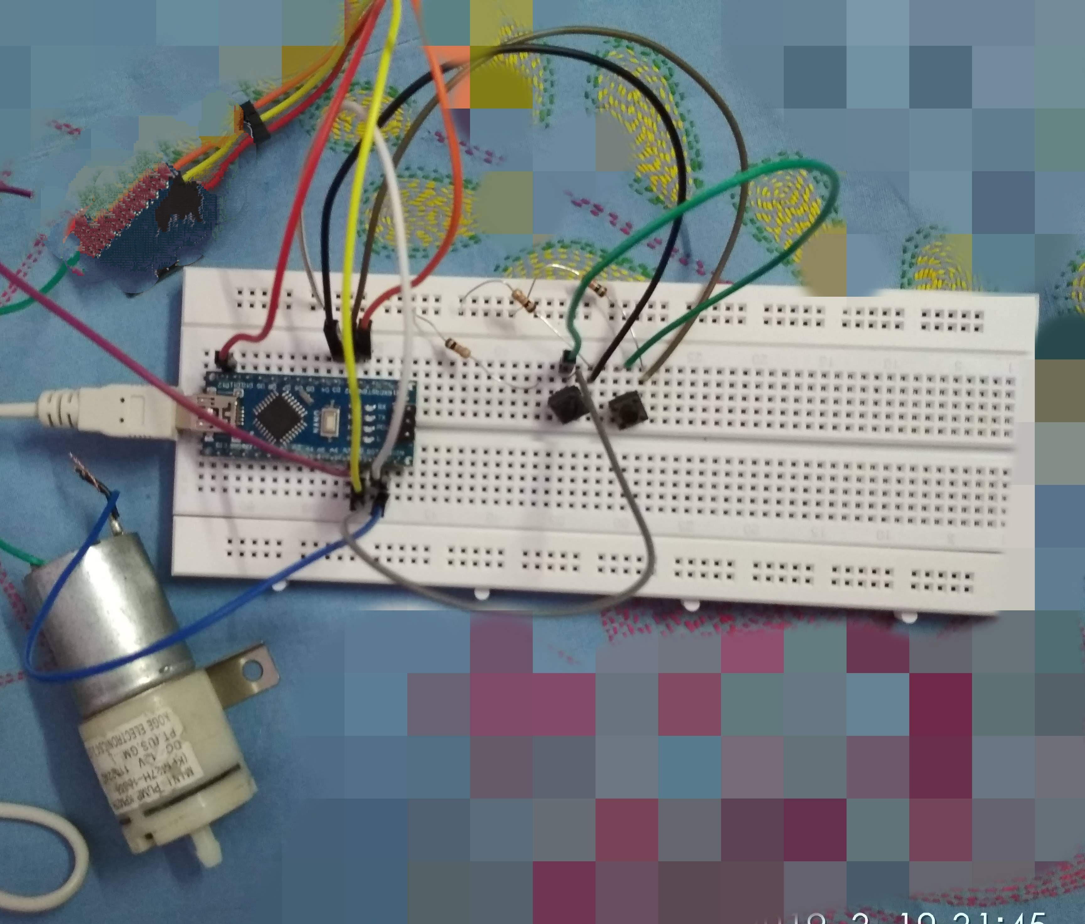
PHOTO ZONE

Slide 15
TESTING
In testing, we have successfully discovered our faults and we took certain measures to avoid it.
The code itself is in the 6th stage because we removed error in each stage.
We checked for:-
a. Code validation.
b. Unit testing for each set.
At first stage of code we test switch and relay connection.
In second stage we test oled display connection.
Next, we test air ump connection.
c. Integrated testing.
Finally, we integrate all our component and test it.
d. Re-modification according to any failure in above methods.
e. Removed redundancy and followed from start.
TESTING

Slide 16
In model making, we used measurable size of cardboard to make it like a real dispenser. We make chamber behind to keep the bottle. We arranged switches and display for better usability and user-friendly manner. We try to make it a ready made device that anyone can use easily.
MODEL MAKING

Slide 17
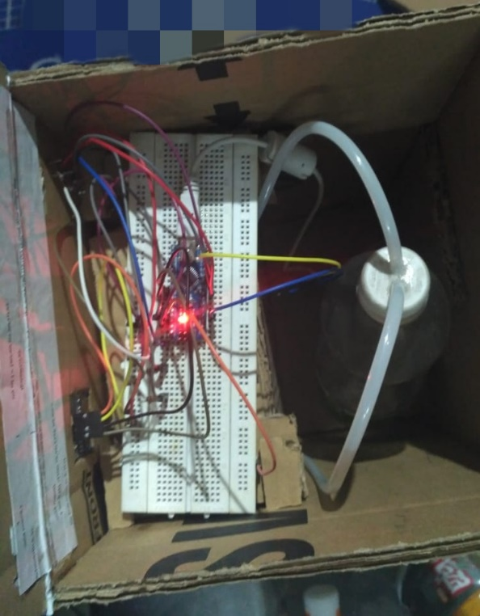
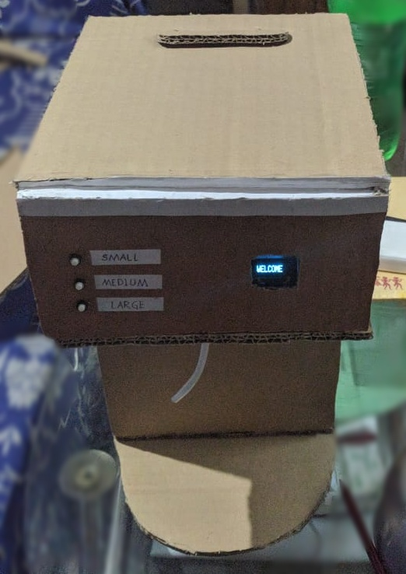
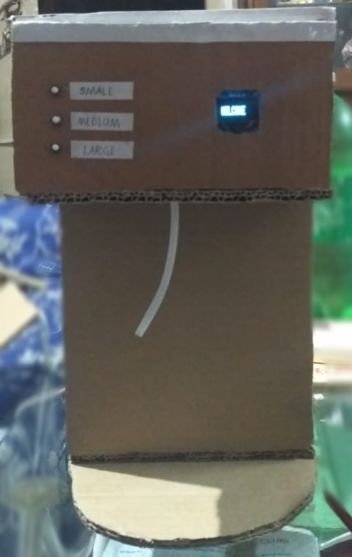
PHOTO ZONE

Slide 18
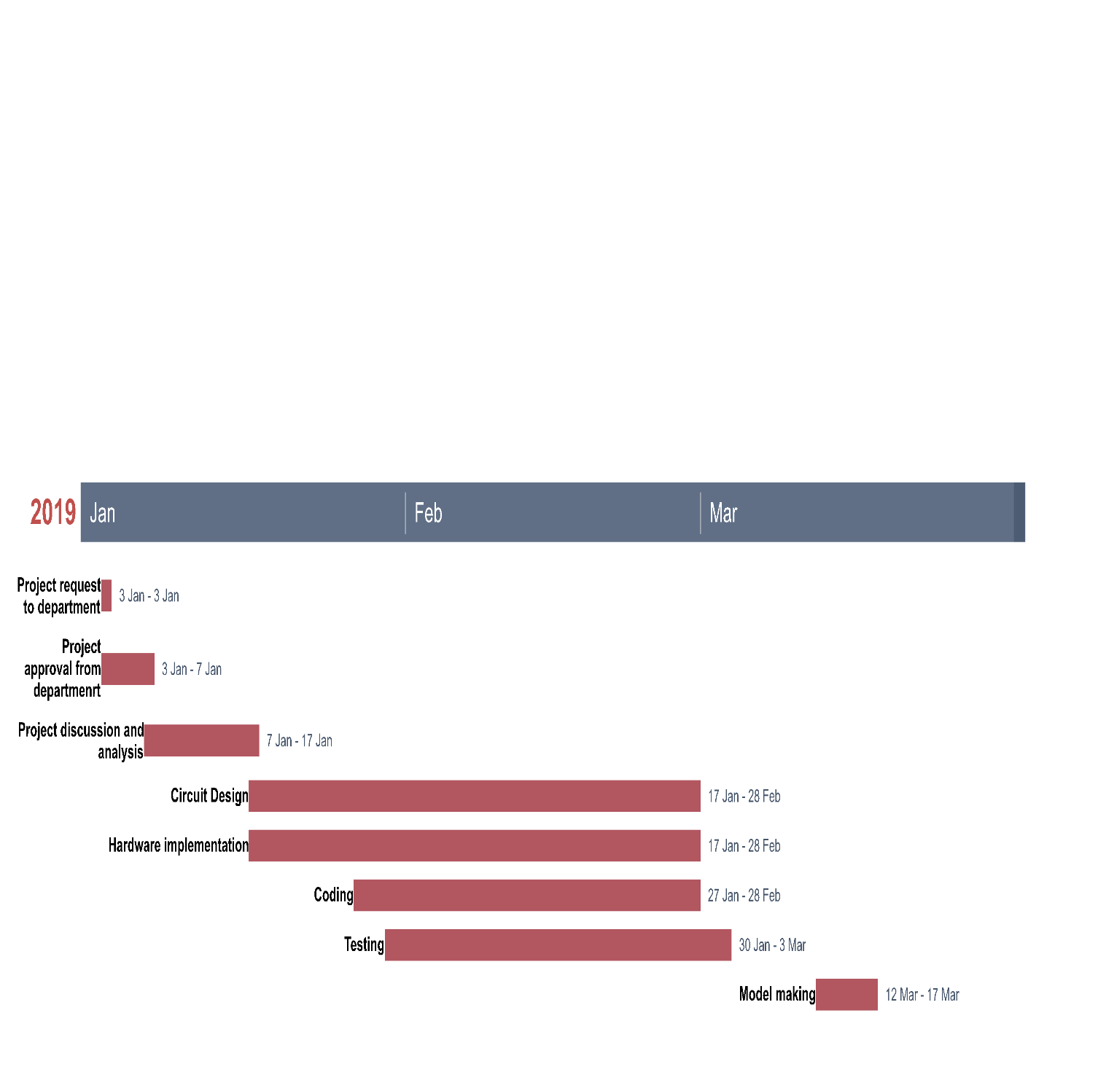
GANTT CHART

